Slide 1

PROJECT OF AAPP K-mer counting
Diego Gaboardi and Giorgio Giardini
Politecnico di Milano

Slide 2
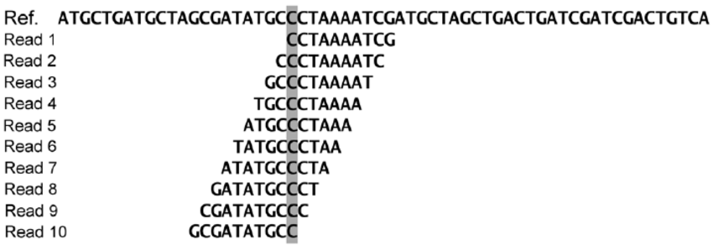


PROBLEM
Counting the number of occurrences of every k-mer in a long string
K-mer substring of length k
USAGE
genome assembly
alphabet = {A,C,G,T}
statistics
knowledge

Slide 3
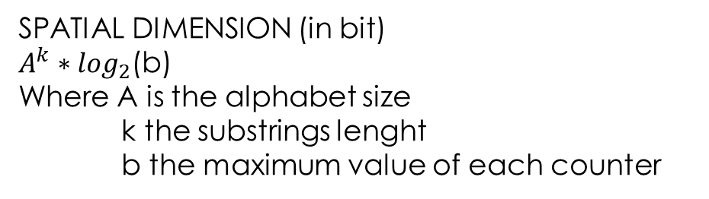
STANDARD IMPLEMENTATION
Hash table
Key: substring (k-mers)
Value: counter
Key
CCTA | ACGT | TTGC | ATCC | AATG | GAAC | TCCG | AGTC | CCAG | TGAA
567 | 234 | 456 | 567 | 234 | 567 | 123 | 673 | 578 | 198
Value
SPATIAL DIMENSION (in bit)
$A^{k}∗\log_{2}$(b)
Where A is the alphabet size
k the substrings lenght
b the maximum value of each counter
TEMPORAL DIMENTION
|S|* table_access_time
Where S is the input string

Slide 4
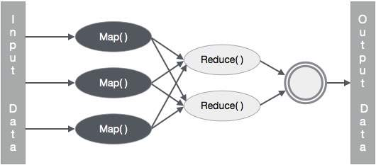
ON MAP REDUCE
Every node process a substring
Straightforward implementation -> map operation emits a series of couples < k-mer , 1 > for each node -> large overhead
Efficient implementation -> map operation includes a counter and emits a series of couples < k-mer , count >
How to obtain efficiently?
Jellyfish parallel algorithm on each node

Slide 5


JELLYFISH
GOALS:
Fast and multithreaded
Memory efficient
SOLUTION:
Lock free Hash-table with CAS assembly instruction
Reduced memory usage of hash entry
Space-efficient encoding of keys
Merging intermediate hash tables

Slide 6
LOCK-FREE HASH TABLE
CAS instruction:
Reads a memory location
Compare the read value to the second parameter of the instruction
If they are equal write the memory with the 3rd parameter
Return the previously held value
Possibility to detect simultaneous access to shared resources
INCREMENT VALUE:
Finds the location in the hash table
It increments the value associated with the key

Slide 7
REDUCED MEMORY USAGE
Using a value field large enough for the most repeated k-mer: INEFFICIENT
Most of the k-mers appear:
1 sequencing error
C sequencing coverage
IDEA:
Small value field
Allow key to have more than one entry

Slide 8
KEY ENCODING
M = 2l lenght of hash-table
pos(m, i) = ( hash(m) + reprobe(i) ) mod M
The position of the key give as information about the l-lower bits
IDEA: store only 2k-l higher bits and the reprobe count
In many application we can obtain a space per key that is independent of the lenght of the l-mers and of the input string

Slide 9
MERGING INTERMEDIATE HASH TABLE
Once computed the hash table is written to disk in order
In this way it is possible to:
Query quickly using binary search
Merge two hash table
If there isn’t enouth memory for the entire computation:
Intermediate results are saved to disk
The hash table is cleared and we begin counting afresh
At the end intermediate results are merged

Slide 10
SIMD
Single Instruction
Same code with a loop cycle
Each iteration of the loop is executed by one of the threads in the team
Multiple Data
Partitioning of the string between the threads
Each thread process a contiguous sequence of characters
!
Border issue: overlapping at border
Thread 1
Thread 2
Thread 3
Thread 4

Slide 11

EVALUATION
3 Version of the algorithm:
Serial version
Multithreaded hash-table with locks
Multithreaded hash-table without locks
We want to:
Show the speed up with respect to the number of threads
How much time it takes with respect to the lenght of the sequence
How much memory is used with respect to the lenght of the sequence

Slide 12
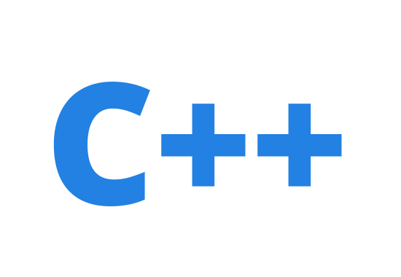



OUR IMPLEMENTATION
Language: C++ & open mp
Support shared memory multiprocessing
Easy to use simply adding some commands to standard C++ code
GIT and GIT HUB
For working in group

Slide 13
WORK PLAN
Parser of the DNA sequence
Serial version of the hash table
Multithreaded hash table with locks
Multithreaded hash table without locks
Make the program memory efficient
Evaluation of the algorithm

Slide 14

POTENTIAL PROBLEMS
Our computers don’t have many cores
Our computers don’t have much memory and DNA sequences are big
We have to familiarize with Open MP since this is the first real project that we do with this API

